Slide 1

Cs 3220: OPERATING SYSTEMS Lecture 1
Instructor:
Osama Ahmed Khan
Assistant Professor, Department of Computer Science, MAJU
osamaahmedkhan OCT 4th, 2021

Slide 2
Websites for Book & Authors
Modern Operating Systems, 4th Edition
Andrew Stuart Tanenbaum
Herbert Bos

Slide 3
processes
Most Central Concept in an Operating System
Abstraction (Instance) of a Running Program
Process = Design (Program) + Input + Output + State
Concurrent operations even on a single Processor (current assumption)
Illusion of Parallelism
Multiprogramming: Processor switches from process to process quickly (usually every tens or hundreds of milliseconds)
Sequential processing
PseudoParallelism
Shares I/O and other resources in a system
Should not be programmed with built-in assumptions about timing
Multiple Processes can run the same program

Slide 4
processes
Program Counter (Instruction Counter)
Indicates where a Processor is in its Program sequence
Holds memory address of next instruction to be fetched
Physical vs. Logical Program Counters

Slide 5
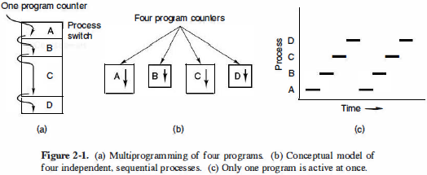
process model

Slide 6
process creation
Events which cause a process to be created:
System initialization
Foreground processes (interacting with users)
Background processes (specific functions, Daemons)
User’s request
A running process calling another process
Batch job initiation
These events are associated with a running process (Parent process)
Executes a system call for process creation
Windows - CreateProcess
Unix - fork
Address spaces of Parent and Child processes are unique and private

Slide 7
process TERMINAtion
Events which cause a process to be terminated:
Voluntary
Normal Exit
Windows - ExitProcess
Unix - exit
Simple Error Exit
Involuntary
Fatal Error Exit
Killed by another process
Windows - TerminateProcess
Unix - kill
Child processes are not terminated (on killing a Parent process) and vice versa in Windows and Unix

Slide 8
process HIERARCHIES
Unix
Process Group
Information is delivered to all members of the group
Each member might take different action on receiving the information
Root process – init
Parent process can not disinherit a Child process
Windows
Process Tree
Parent process is given a token (handle) to control the Child process
Parent process can disinherit a Child process by passing the token to some other process

Slide 9
process STATES
Running
Using the Processor
Ready
Waiting for its turn to use the Processor
Resource problem
Blocked
Waiting for complete input in order to be ready
Inherent problem

Slide 10
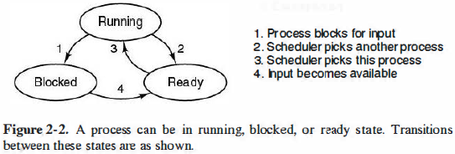
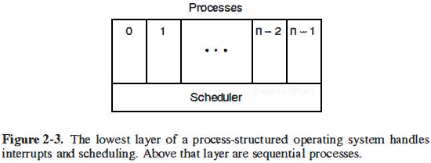
process STATES

Slide 11
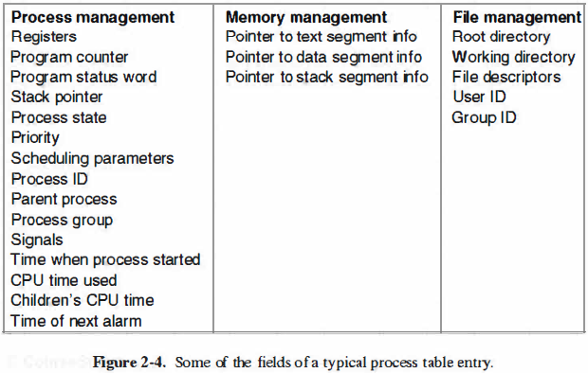
implementation of processes
Process Table (for each Process)
Process Control Blocks (PCBs)
Information saved to be retrieved later

Slide 12
implementation of processes
Interrupt Vector
Small part of Memory
Contains address of Interrupt Service Procedure
Interrupt Hardware
Moves a Process’ PCBs onto Stack on receiving an Interrupt
Moves back the Process’ PCBs from temporary Stack on finishing the Interrupt request
Interrupt Service Procedure
Moves the Process’ PCBs from Stack to a temporary Stack
Transferring Process’ PCBs (to and fro) is done in Assembly language

Slide 13
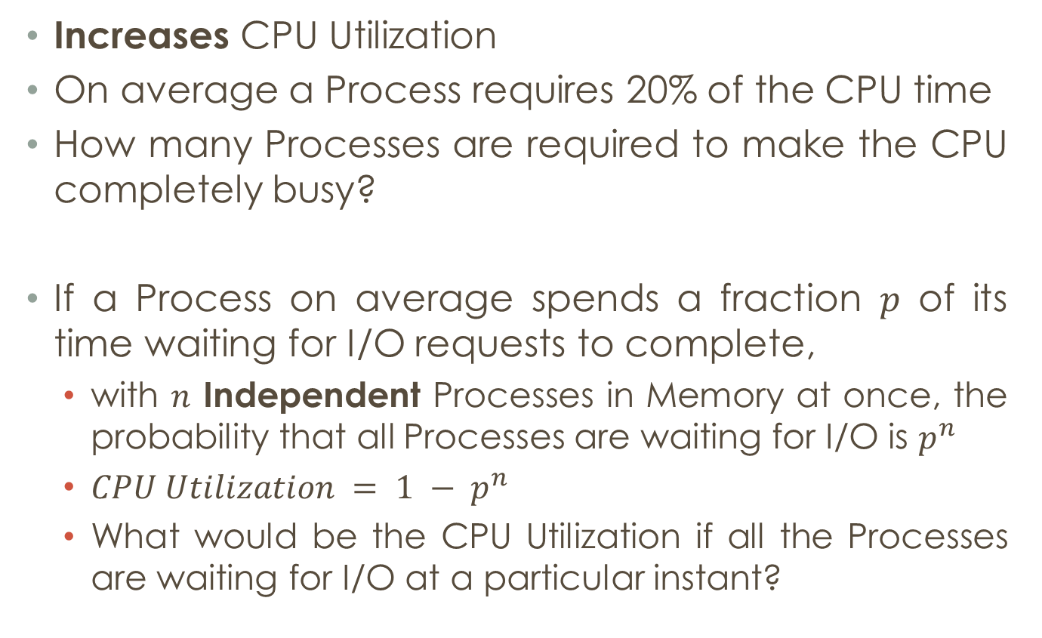
modeling multiprogramming
Increases CPU Utilization
On average a Process requires 20% of the CPU time
How many Processes are required to make the CPU completely busy?
If a Process on average spends a fraction $p$ of its time waiting for I/O requests to complete,
with $n$ Independent Processes in Memory at once, the probability that all Processes are waiting for I/O is $p^{n}$
$CPU Utilization = 1 − p^{n}$
What would be the CPU Utilization if all the Processes are waiting for I/O at a particular instant?

Slide 14
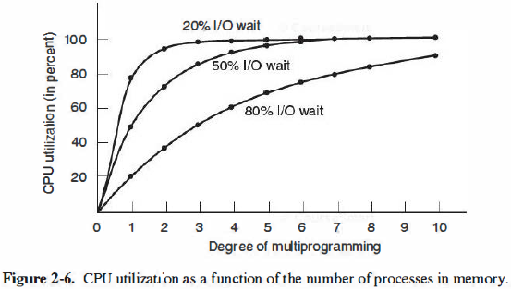
modeling multiprogramming

Slide 15
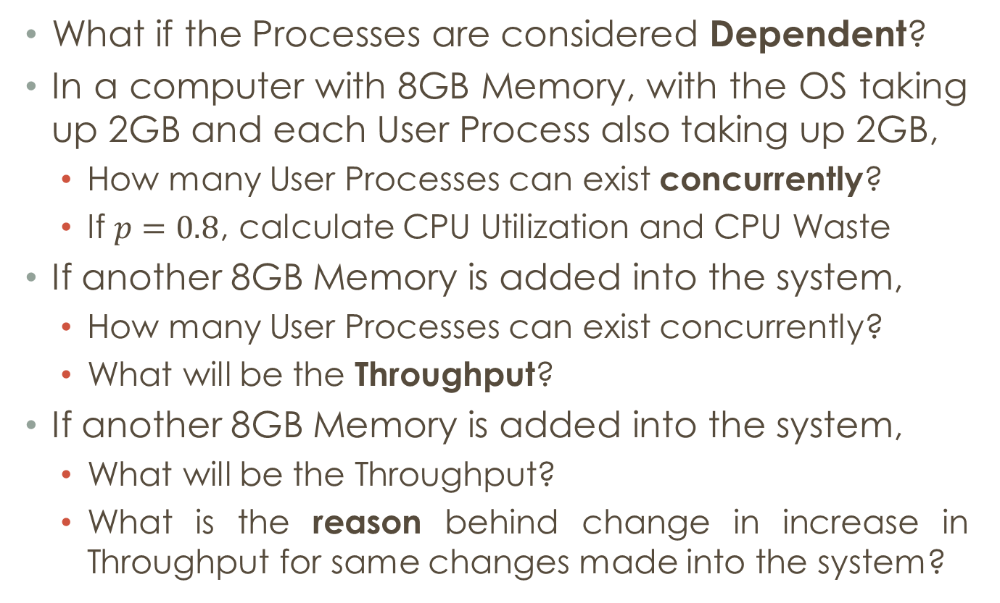
modeling multiprogramming
What if the Processes are considered Dependent?
In a computer with 8GB Memory, with the OS taking up 2GB and each User Process also taking up 2GB,
How many User Processes can exist concurrently?
If $p=0.8$, calculate CPU Utilization and CPU Waste
If another 8GB Memory is added into the system,
How many User Processes can exist concurrently?
What will be the Throughput?
If another 8GB Memory is added into the system,
What will be the Throughput?
What is the reason behind change in increase in Throughput for same changes made into the system?

